Slide 1
How To Activate Your Employees For Marketing
(HR and Sales) Success
ANYONE can use this template for their executives and employees
Michael Brenner
Speaker, Author, CEO,
Marketing Insider Group
@BrennerMichael

Slide 2
How To Activate Your Employees For Marketing
(HR and Sales) Success
Download the slides here:
http://bit.ly/activate-your-employees
Michael Brenner
Speaker, Author, CEO,
Marketing Insider Group
@BrennerMichael

Slide 3
Employee Activation
What We’re Going To Cover
The value of activating your employees
Why your employees are the most powerful marketing and sales channel
What’s in it for them?
What’s in it for HR?
How everyone can activate their employees

Slide 4
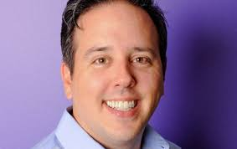
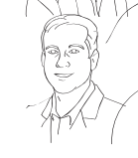
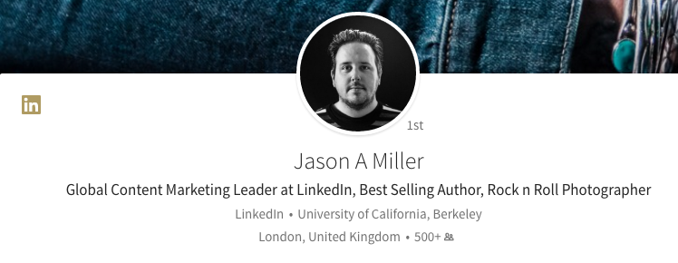
Notes:
Images used with permission

Slide 5
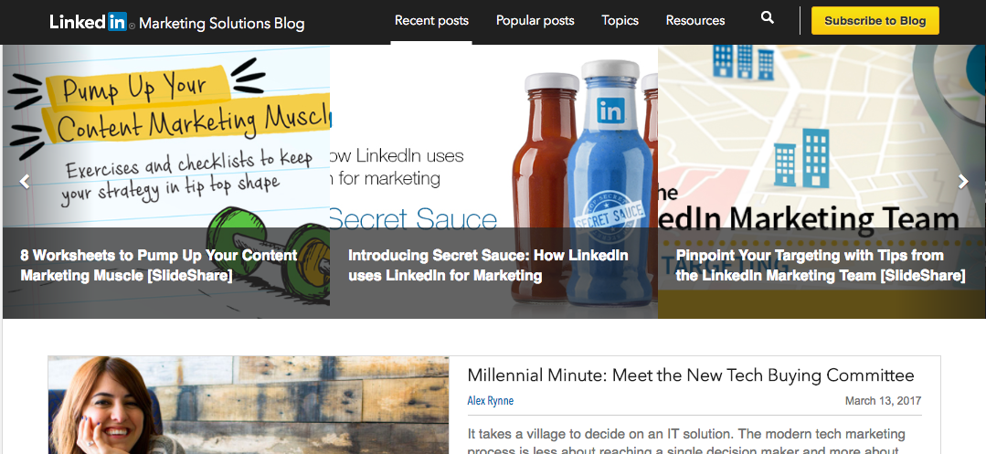
Does it matter?
Employees 10X > company
3% employees = 30% reach
3 shares = job, company, profile views
= 1 connection, company follow
Notes:
Images used with permission

Slide 6
The Buyer (and Talent) journey is nothing more than a series of questions.

Slide 7
Your employees = experts
Executive PowerPoints = slideshares
Campaign Whitepapers = posts
Customer Service and Sales FAQs
Emails = answers to customer questions
Notes:
Giphy.com

Slide 8
What’s the Value?
3 posts / day - Reached 23 Million - 60,000 clicks
3 posts / day - 22 Million - 58,000 clicks
2 posts / day - 18 Million - 49,000 clicks
Notes:
Images used with permission

Slide 9
HR is the The New Marketing
3 employees
8 posts / day
63 Million Impressions
167,000 clicks
“Tons of Pipe”
“Show them what’s in it for them:”
Grow connections
Build you personal brand
Propel your career

Slide 11
How To Activate Your Employees For Marketing
(HR and Sales) Success
ANYONE can use this template for their executives and employees
Michael Brenner
Speaker, Author, CEO,
Marketing Insider Group
@BrennerMichael

Slide 13
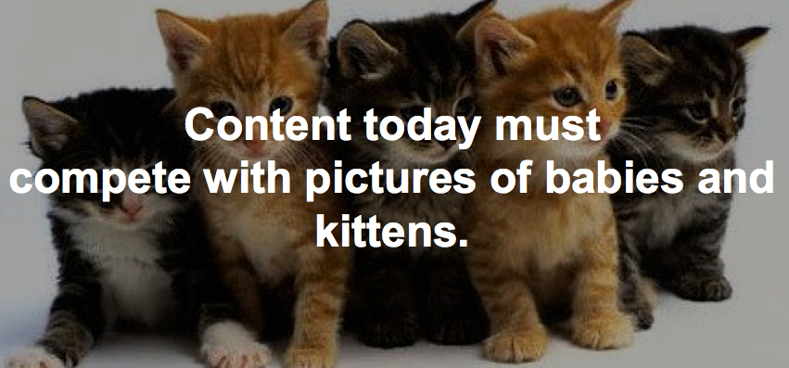

Slide 14
60-70% of marketing content
goes completely unused.
*Sirius Decisions
Notes:
Image: Pixabay royalty-free images

Slide 15
Most of Our Content Is All About Us

Slide 16
Paid Tactics Deliver Only 6% of Web Traffic
Source: http://www.regalix.com/by_regalix/research/reports/state-of-b2b-search-marketing-2015/

Slide 17
Ads Won’t Get Us
In Front of Real
Buyers When…
Sales DECLINE after buyers see 40 ads from a brand
~ Advertising Research Foundation, Aug, 2016
Notes:
Source: AdAge.com

Slide 18
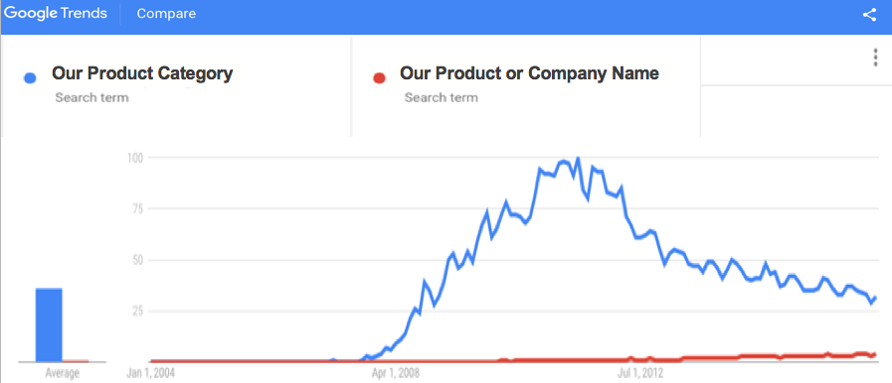
More Prospects Are Searching For
Answers To Questions (vs Our Products)
Do your own search:
https://trends.google.com/trends/

Slide 19
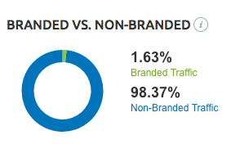
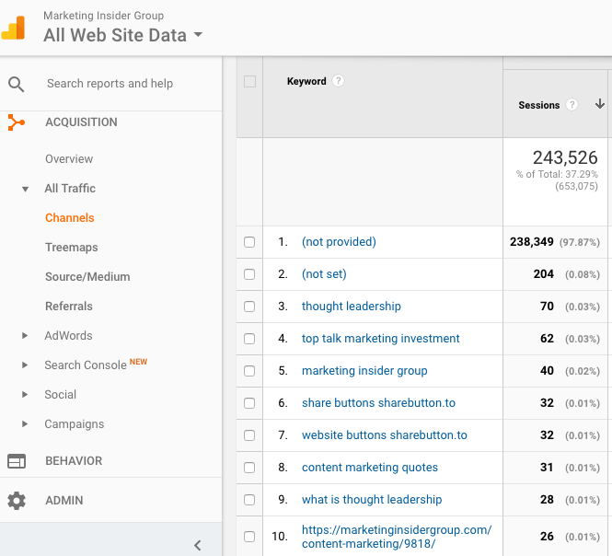
How Many Of Those Unbranded Searchers Find Their Way To Our Site?
In Google Analytics, go to “ACQUISITION > CHANNELS >
ORGANIC SEARCH.
(Even though many search keywords are masked, you can assess how much unbranded search traffic you get from the unmasked data.)
An effective website will have more than 90% of the search traffic from unbranded search.
You can use a tool like SEMRush, or your web analytics to assess.

Slide 20
Do you organically show up on the first page of Google for an unbranded search?

Slide 21
Email, Search & Social --
Content is Responsible for 90% of Content Discovery
Search
Email
Social
Source:
KoMarketing Associates

Slide 23
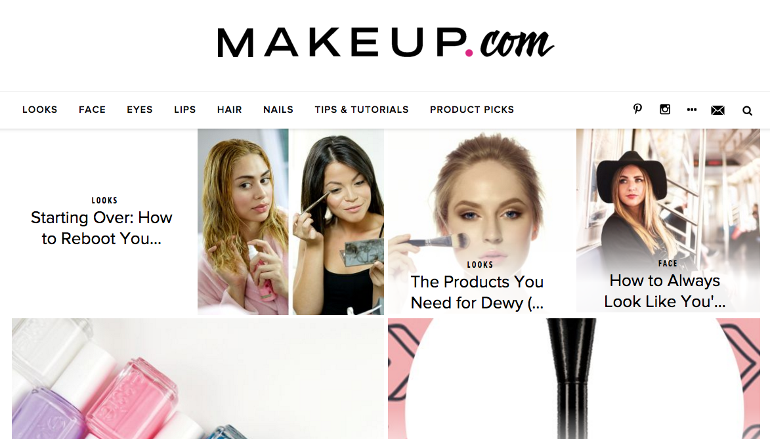
IMAGINE: We Own The Category like…
www.makeup.com -- (owned by L’Oreal)

Slide 24
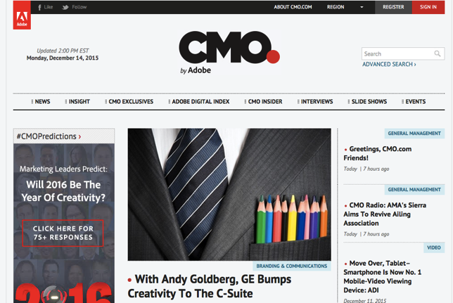
IMAGINE: We own the target audience like…
www.CMO.com -- owned by Adobe

Slide 25
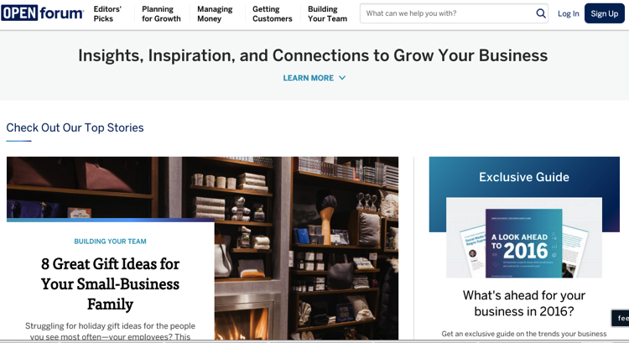
IMAGINE: Marketing that attracts new buyers like…
AMEX OPEN Forum is the largest source of new leads for AMEX’s Small Business Division

Slide 26
To achieve marketing success, we need a strategy to reach, engage, and convert new customers.
Customers we would have never seen
without an effective content marketing strategy.

Slide 27
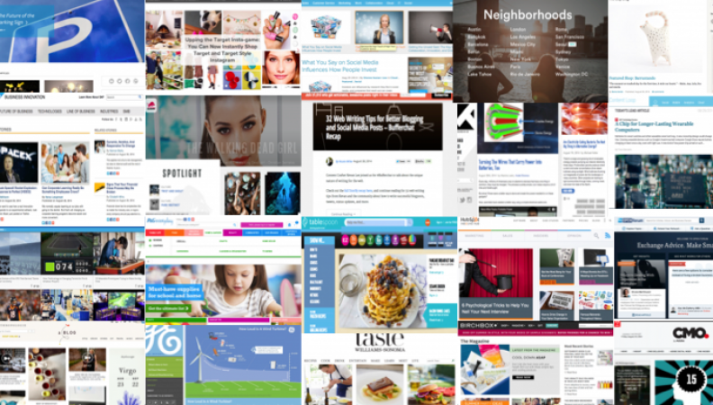
So we are building
a Content Marketing destination (like one of these)…
http://marketinginsidergroup.com/content-marketing/best-content-marketing-hub-examples/

Slide 28
Our Mission
We will become the premier destination
for [your target audience]
interested in [what TOPIC]
to help them [customer value].
In order to deliver [our marketing goal]
(awareness, leads, etc.)

Slide 29
And we need your help

Slide 30
NOW is the time to build your Personal Brand

Slide 31
I think I know what you’re thinking?
The top reasons people give for not working out, not eating right, or not building a personal brand:
I’m too old
I don’t have the time
It’s not important (I don’t see the value)
I don’t know how

Slide 32
You already have a personal “brand.”
Are you managing it?
What is personal branding?” Those characteristics that make you unique and how you communicate that to the world. The objective of personal branding is professional success and is directly linked to the success of the company we serve.

Slide 33
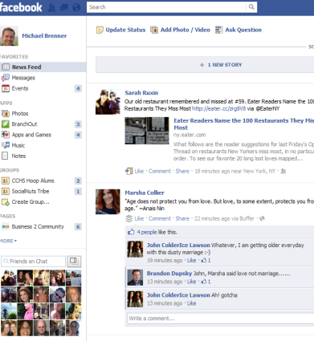
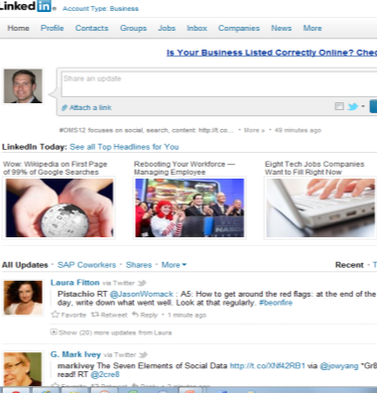
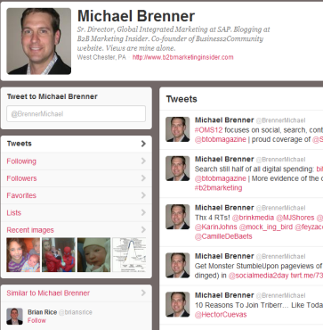
50 years ago, Gallup released research that said delivering news is the most effective way to attract people to your business…
TODAY WE CREATE THE NEWS!!!

Slide 34
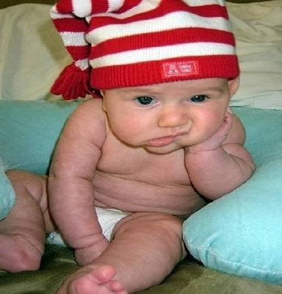
Most content is just plain boring?

Slide 35
Because it does this…
Me, me, me
Blah
Blah
Blah

Slide 36
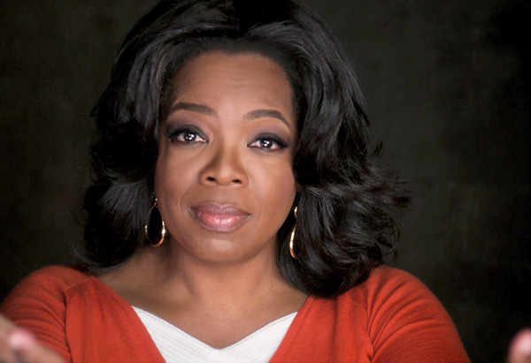
But should do this…
I care...
I really
REALLY
DO!

Slide 37
Or just answer common questions…
What?
Why?
How?
Who?
When?

Slide 38
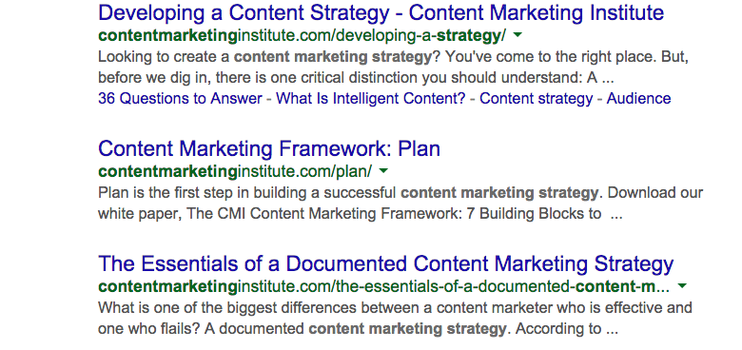

Slide 39
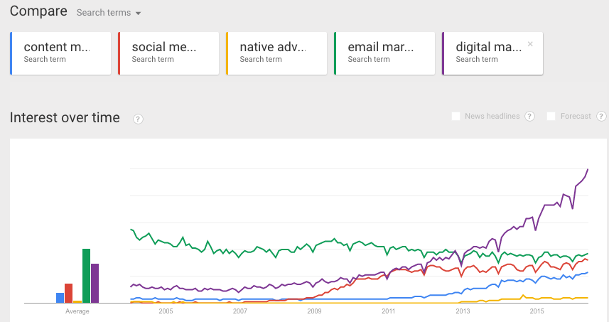

Slide 40
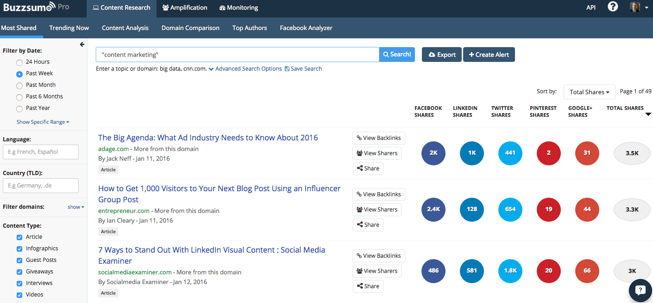

Slide 41
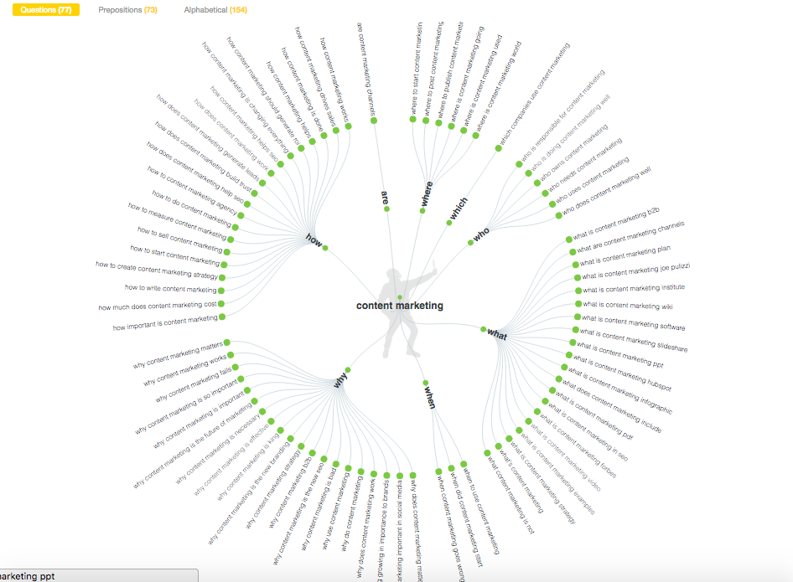

Slide 42
“Write about what you know” ~ Mark Twain

Slide 43
Tips For Personal Branding Success …
Define your audience and set a goal
Why are you talking? To help someone with what you know and / or love
Who are you talking to? Imagine it’s just one actual person
What’s in it for them / you?
Build it in to every day
Scan, filter, read, connect, write, respond
Personal branding success = minutes per day
Have a goal: 2 blogs per week Tues / Thursday
Build relationships of mutual benefit
Give Social “gifts:” (Retweet me, I might ReTweet you! )
The new content rules
If it isn’t a keyword, no one cares
Titles matter
Great images are important
Bullets help
Tell stories: Hero, has a quest, goes on a journey, faces an obstacle, achieves goal

Slide 45
Employee Activation
Key Takeaways
Your employees are all experts in something
Your own employees can be the most powerful marketing and sales channel
Activating employees increases their own value to the marketplace
Activating employees increases HR objectives or attracting top talent and engaging existing employees
Every company and leader should encourage their employees to build their personal brand

Slide 46
How To Activate Your Employees For Marketing
(HR and Sales) Success
Download the slides here:
http://bit.ly/activate-your-employees
Michael Brenner
Speaker, Author, CEO,
Marketing Insider Group
@BrennerMichael

